Slide 1

Goel Institute Of Technology And Management
Inventory Management System
Bachelor of Technology
In
Computer Science And Engineering
SUBMITTED TO
Mr. Shivam Shukla
(College Training Head)
SUBMITTED BY
Sudhanshu Singh
1903600100053

Slide 2
Content
Introduction
Purpose
Project Scope
Requirements
Interface
Software Requirment
Levels of Users
Usecase Diagram
Snapshots

Slide 3
INTRODUCTION
The project “Inventory Management System” is developed in Oracle Apex, which contains mainly following pages that have some special purpose:-
Inventory Dashboard
Inventory Home
Manage Inventory
Manage Branch
Manage Department
Manage Location
View Inventory
View Branch
View All Reports

Slide 4
Purpose
Easy to Handle All Services of Inventory.
Maintain and Store all The record of Inventory System, Dashboard, Manage Inventory, View Inventory, Manage Branch, Manage dept.
View All Reports.
Share all the Inventory related Information and Announcement.
Give a quick response to customers for there doubts .
Show all the Basic information to customer without visit the Inventory management system.

Slide 5
PROJECT SCOPE
The scope of an inventory system can cover many needs.
valuing the inventory, measuring the change in inventory and planning for future inventory levels.
The value of the inventory at the end of each period provides a basis for financial reporting on the balance sheet.

Slide 6
REQUIREMENTS
1)Functional Requirements:
Dashboard Home.
Home.
Inventory Systems.
Manage All Inventory.
Manage All Reports
View All Details.
2)Non Functional Requirements:
Safety requirements
Security requirements
Hardware Constrains

Slide 7
INTERFACE
1)Hardware Interface:
Processor: core i3 or more.
RAM: 2GB or 4GB and many more.
Hard Drive: 10 GB or more.
2)Software Interface:
Operating System: Window XP/7/8/10/11 or more.
Front End: Oracle Apex.
Back End: Oracle 21C database(cloud version of oracle)
Language: SQL , PL/SQL.

Slide 8
SOFTWARE REQUIREMENTS
SQL Language
PL/SQL Language
HTML,CSS, JS
Rapid Application Development Tool

Slide 9
LEVELS OF USERS
We have three levels of users
1) Admin Side:-
Admin id and Password is available for Following department Incharge.
Inventory System
Manage Inventory
Manage All Department
View Reports
Dashboard
2)Users Side:-
Users have access of :-
Inventory Portal
All Branches side Features
View All Details

Slide 10
USE CASE DIAGRAM
Login page
Inventory Dashboard
Manage Inventory
Manage Branches
Customers
View All Details
Admin
View all Reports
Audit Information

Slide 11
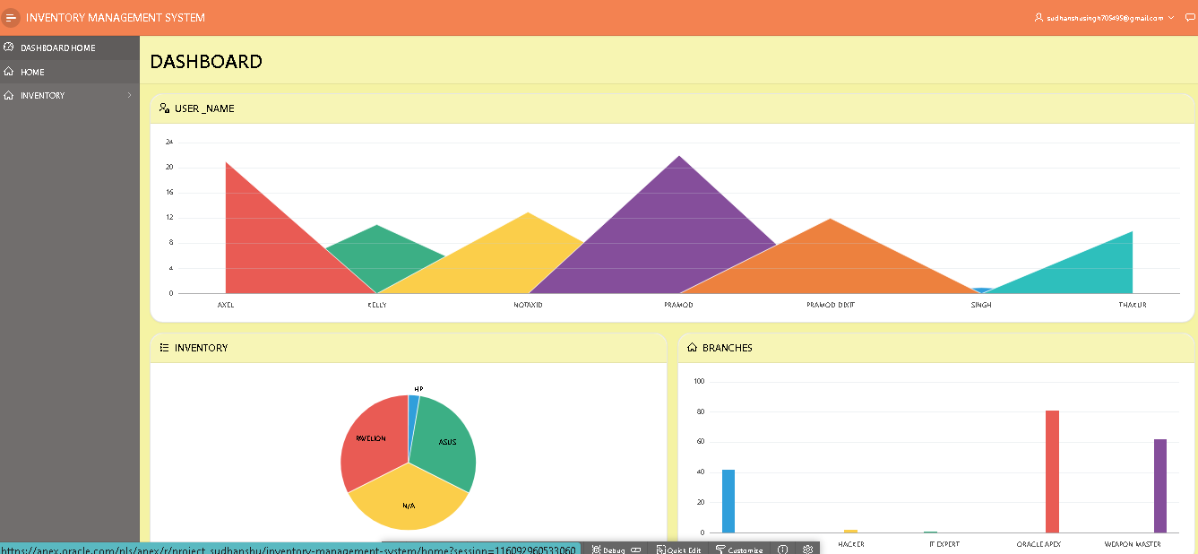
Some Screenshot of the Project

Slide 12
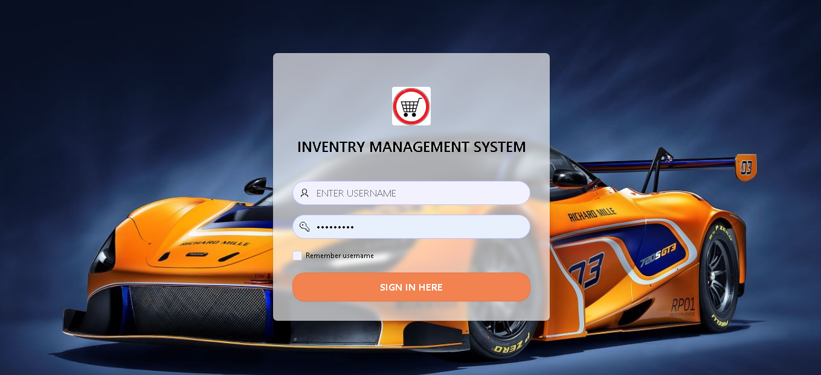
lOGIN page

Slide 13
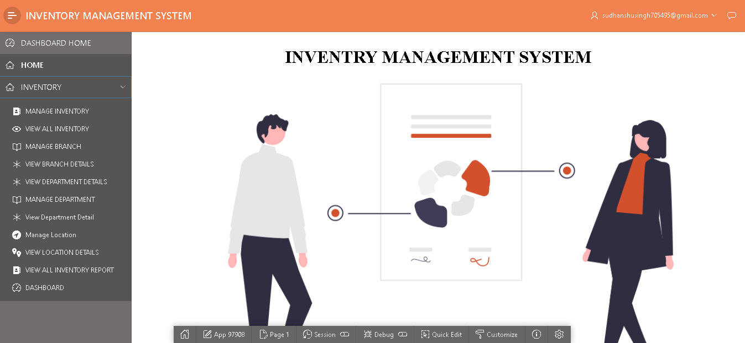
Admin Page

Slide 14
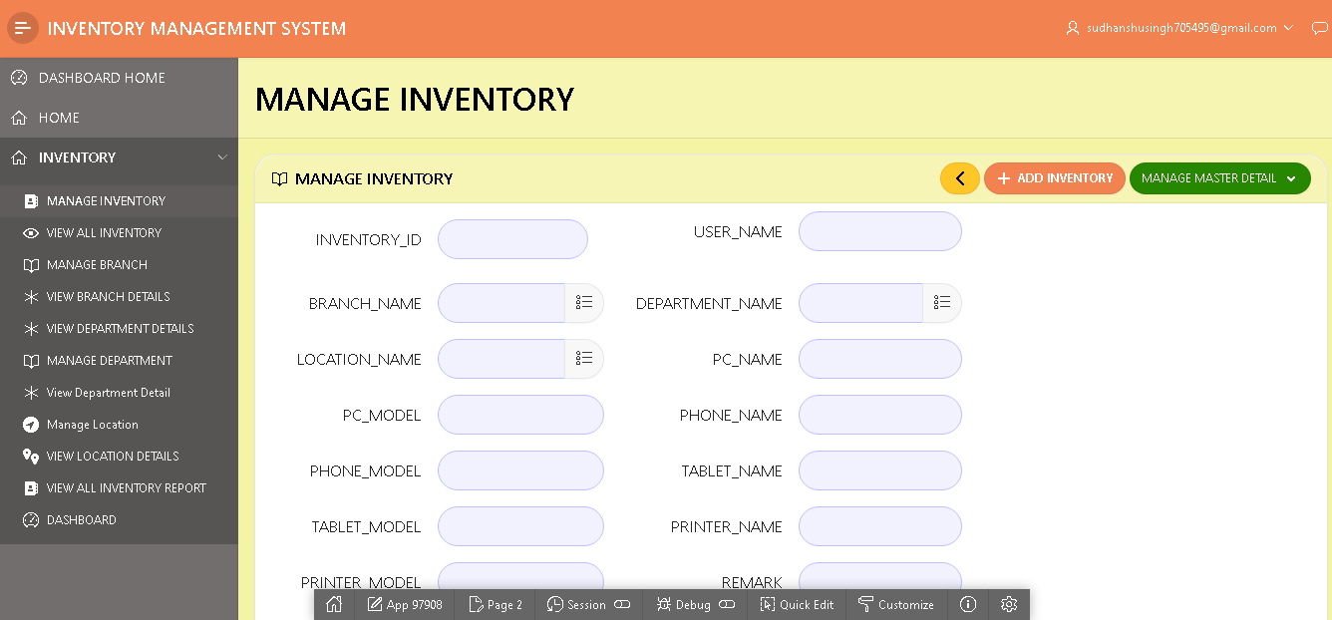
Inventory system

Slide 15
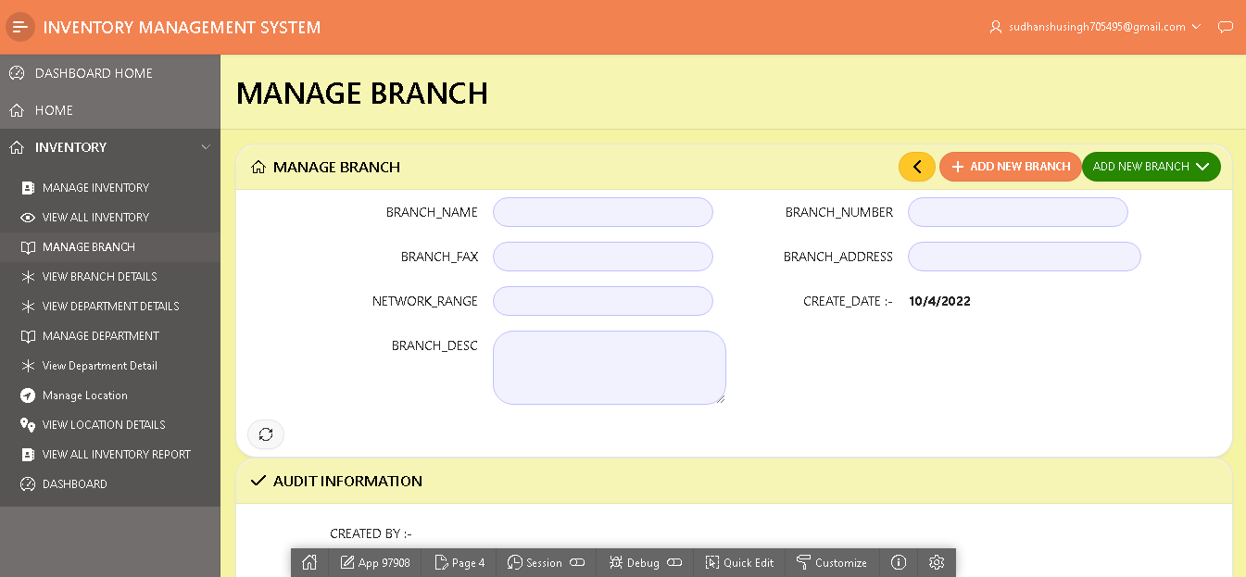
Inventory BRANCH

Slide 16
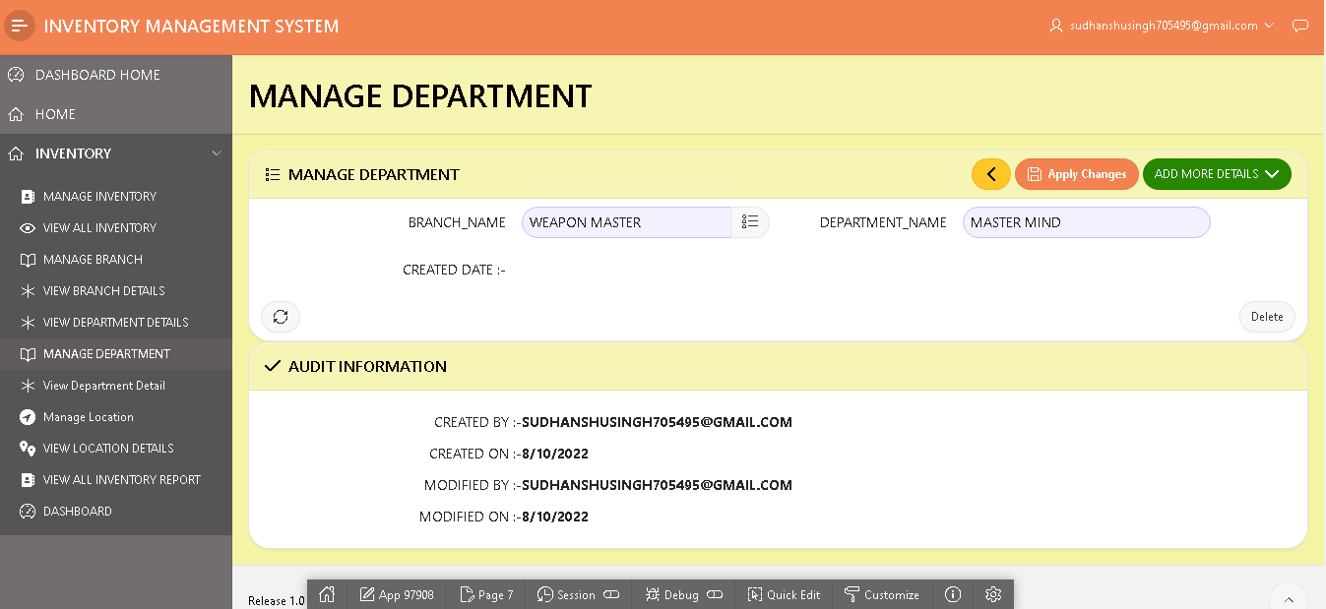
INVENTORY DEPT

Slide 17
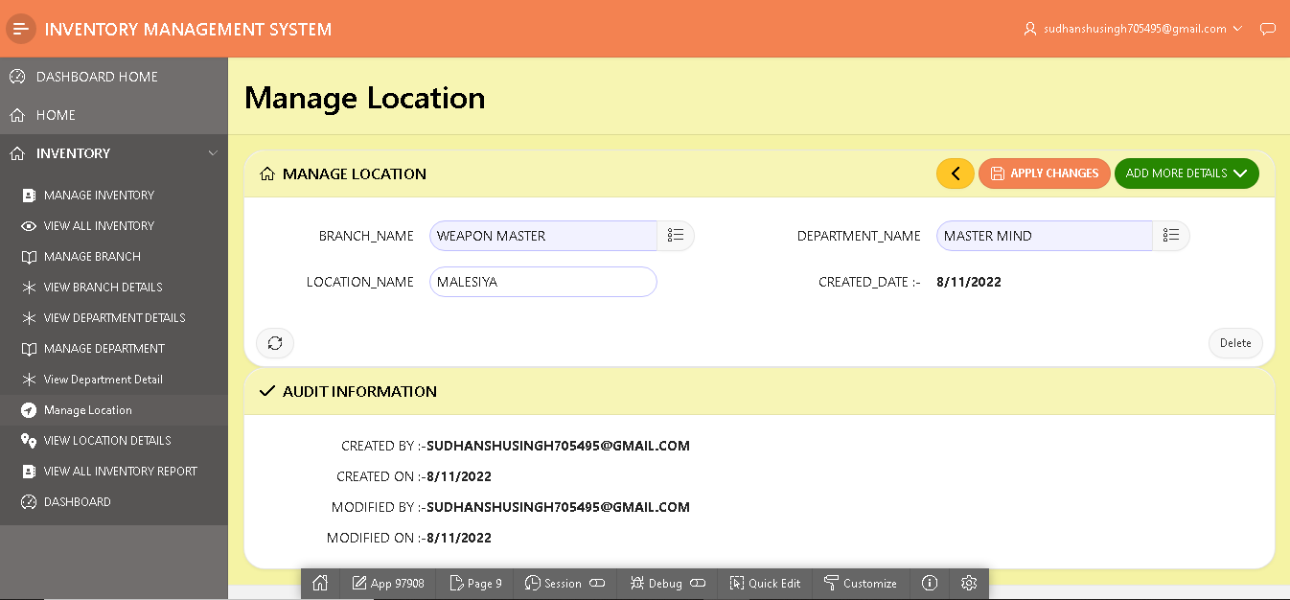
INVENTORY LOCATION

Slide 18
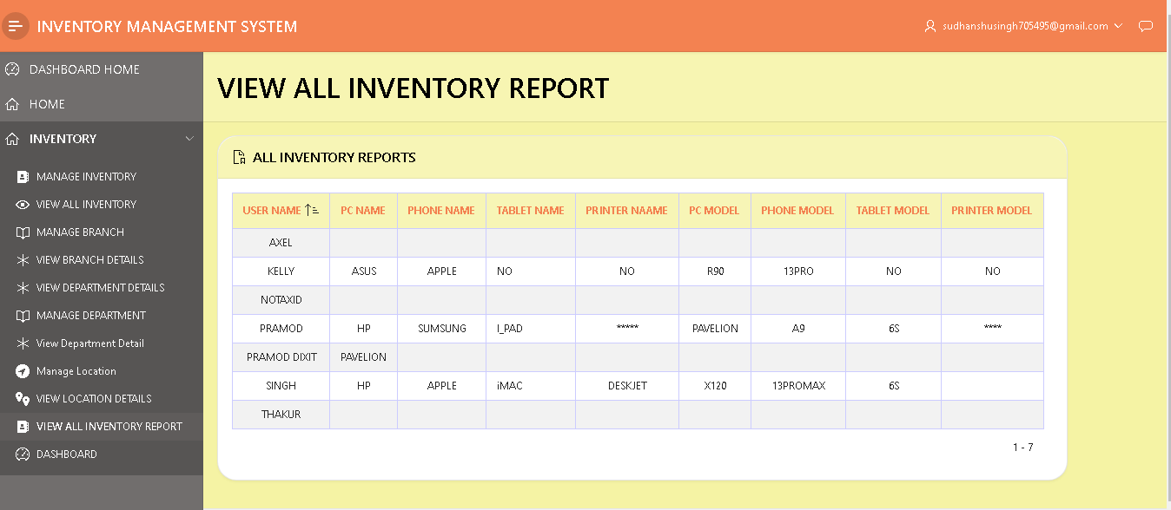
VIEW REPORTS

Slide 19
THANK YOU
SO
MUCH
🙏🙏

